Slide 1
Google GCP and AI
.Net Users Group
^{t}18th December 2018

Slide 2
Agenda
What is Google Cloud Platform?
Why focus on AI and some of the basics
I’m a developer, get me out of here!
Demo application
Lessons Learned

Slide 3
What is Google Cloud Platform?
Why use it?

Slide 4
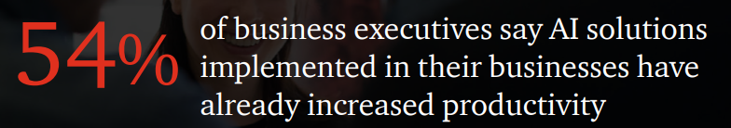
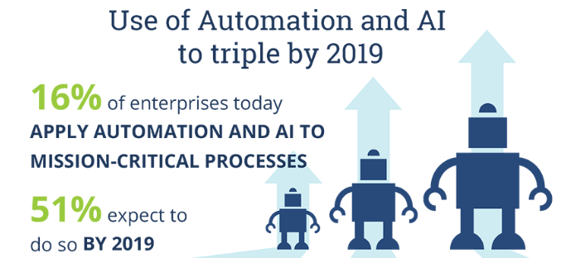
Why focus on AI?
(PwC Consumer Series 2017)
High adoption expected.
“No brain, no gain”
Two-thirds of companies
struggle with finding and
acquiring AI talent
83% struggle with retention.
One solution (Hire.google.com) is using AI to find AI developers.
To help bridge the gap, cloud suppliers are providing “pre-trained” models.
(ISG 2018)

Slide 5
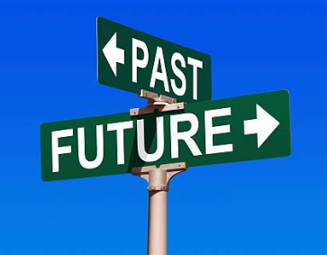
The basic AI Concept
In 1905 George Santayana a philosopher said, “Those who cannot remember the past are condemned to repeat it”
In 1980 Dr. Carl Sagan a cosmologist said, “You have to know the past to understand the present.”
In 2012 Robert T Kiyosaki an accountant said, “The best way to predict the future is to study the past, or prognosticate.”
AI model training is all about analyzing the past to predict the future.

Slide 6

I’m a developer, not a data scientist
Neural Nets are not simple. Tools mainly are designed for data scientist by data scientist.
For Dev there are a few out of the box APIs
Vision API (Label, extract Text, Web search)
Video API (extract metadata)
Translation
Text-to-Speech
Natural Language (extract intent, main use is for Bots)
As always, it’s not long before you get to the last 10% for functionality that takes 90% of the effort.

Slide 7

Landmark Example
Landmarks – Where is this?

Slide 8
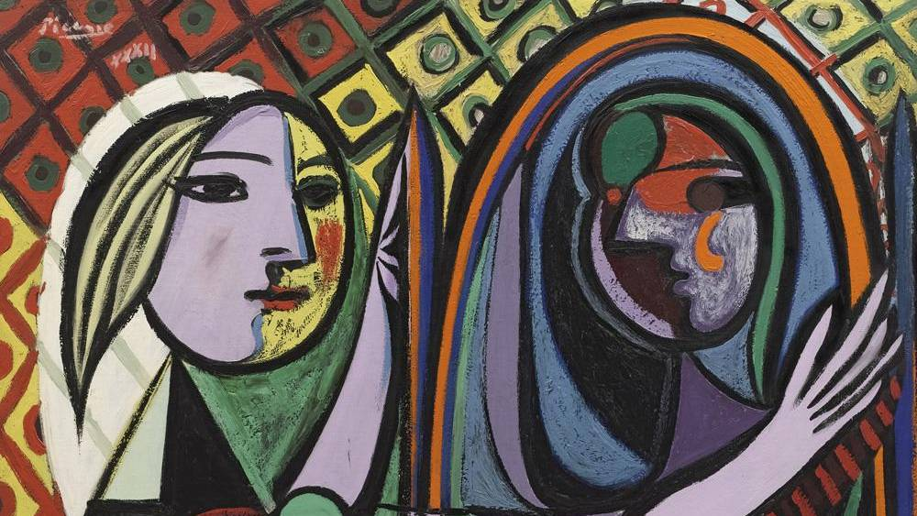
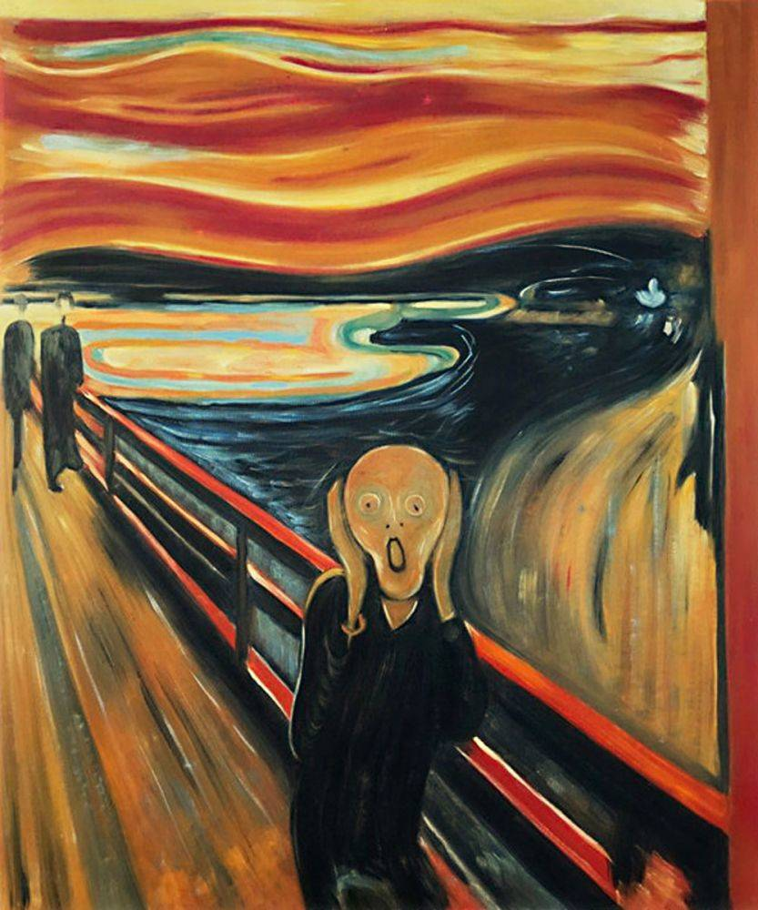
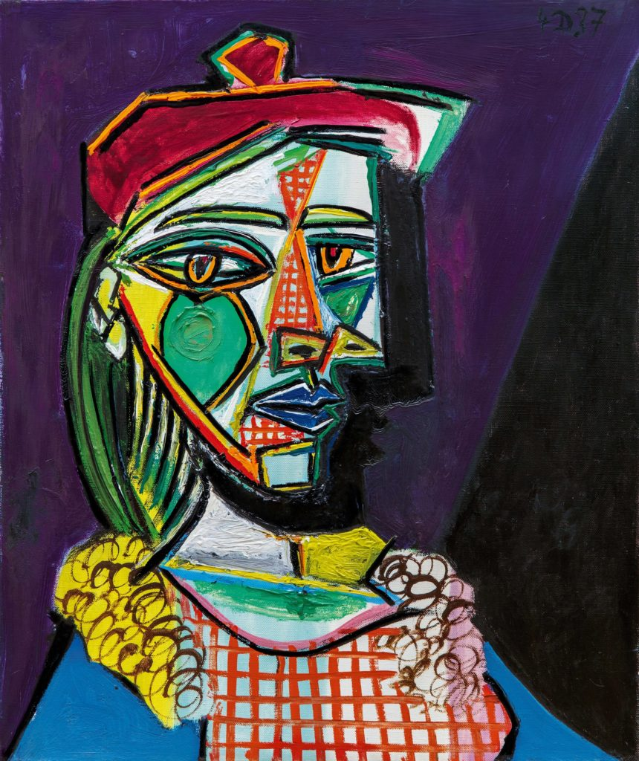
Label Example
Label – what description would you give?

Slide 9
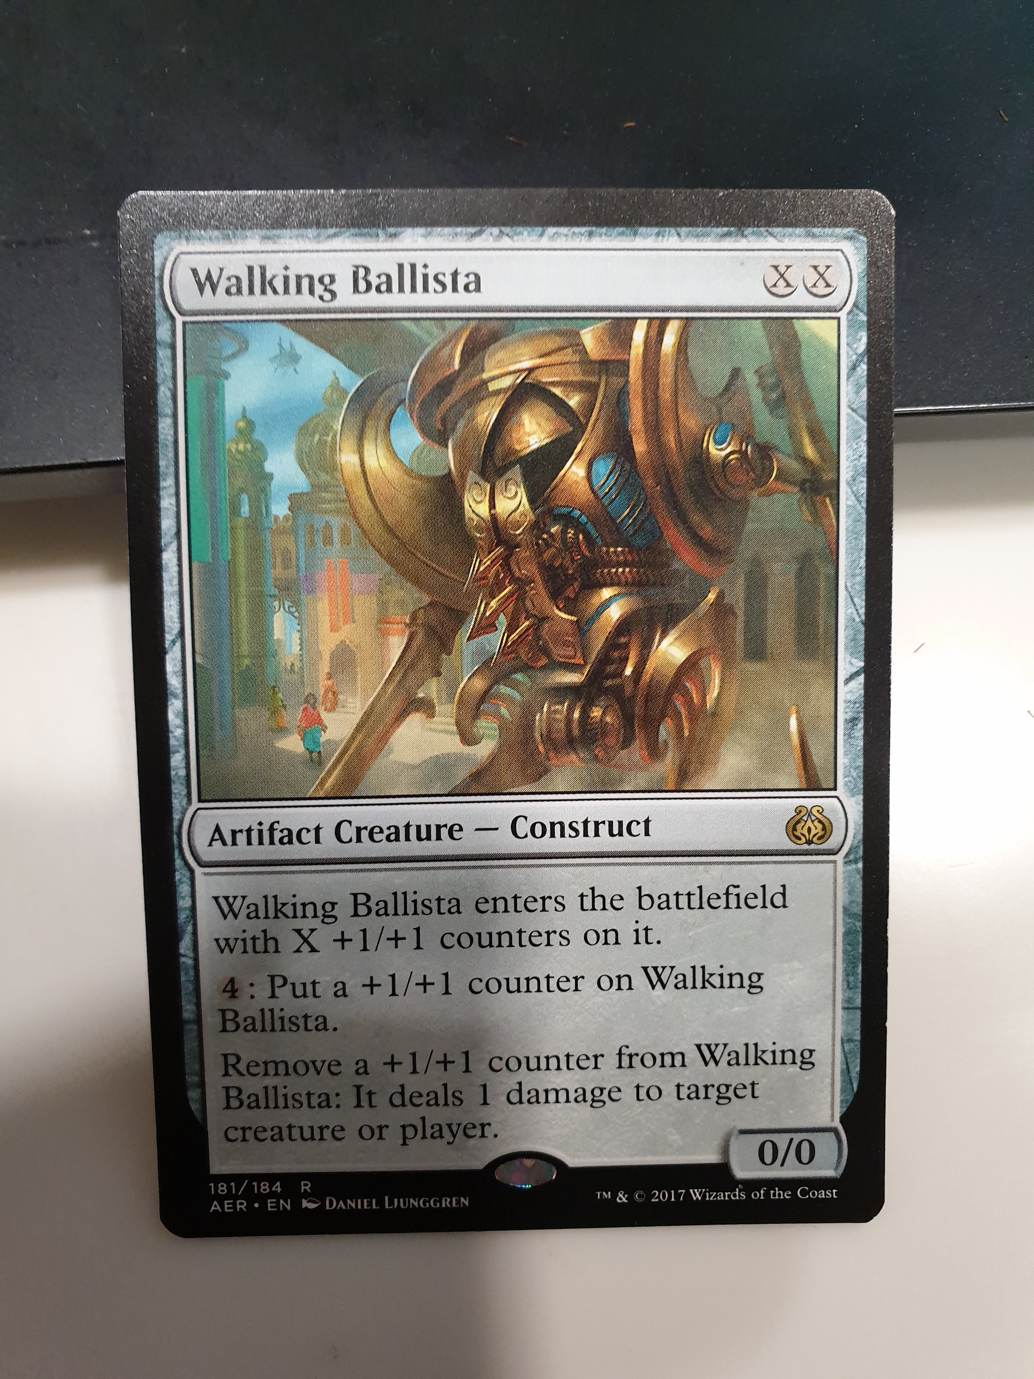
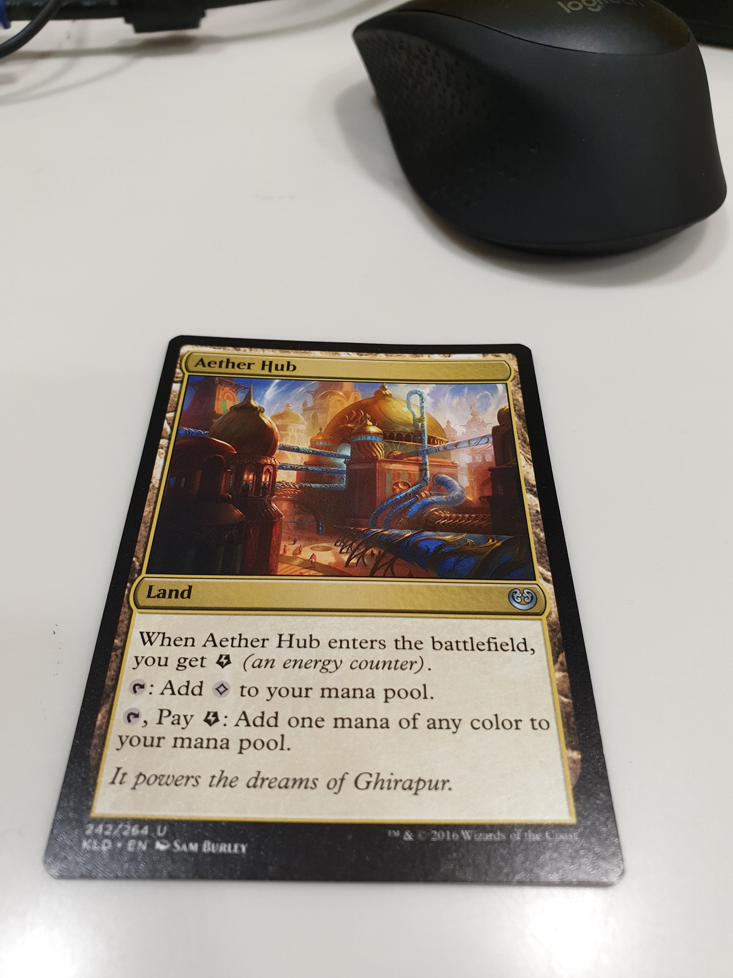
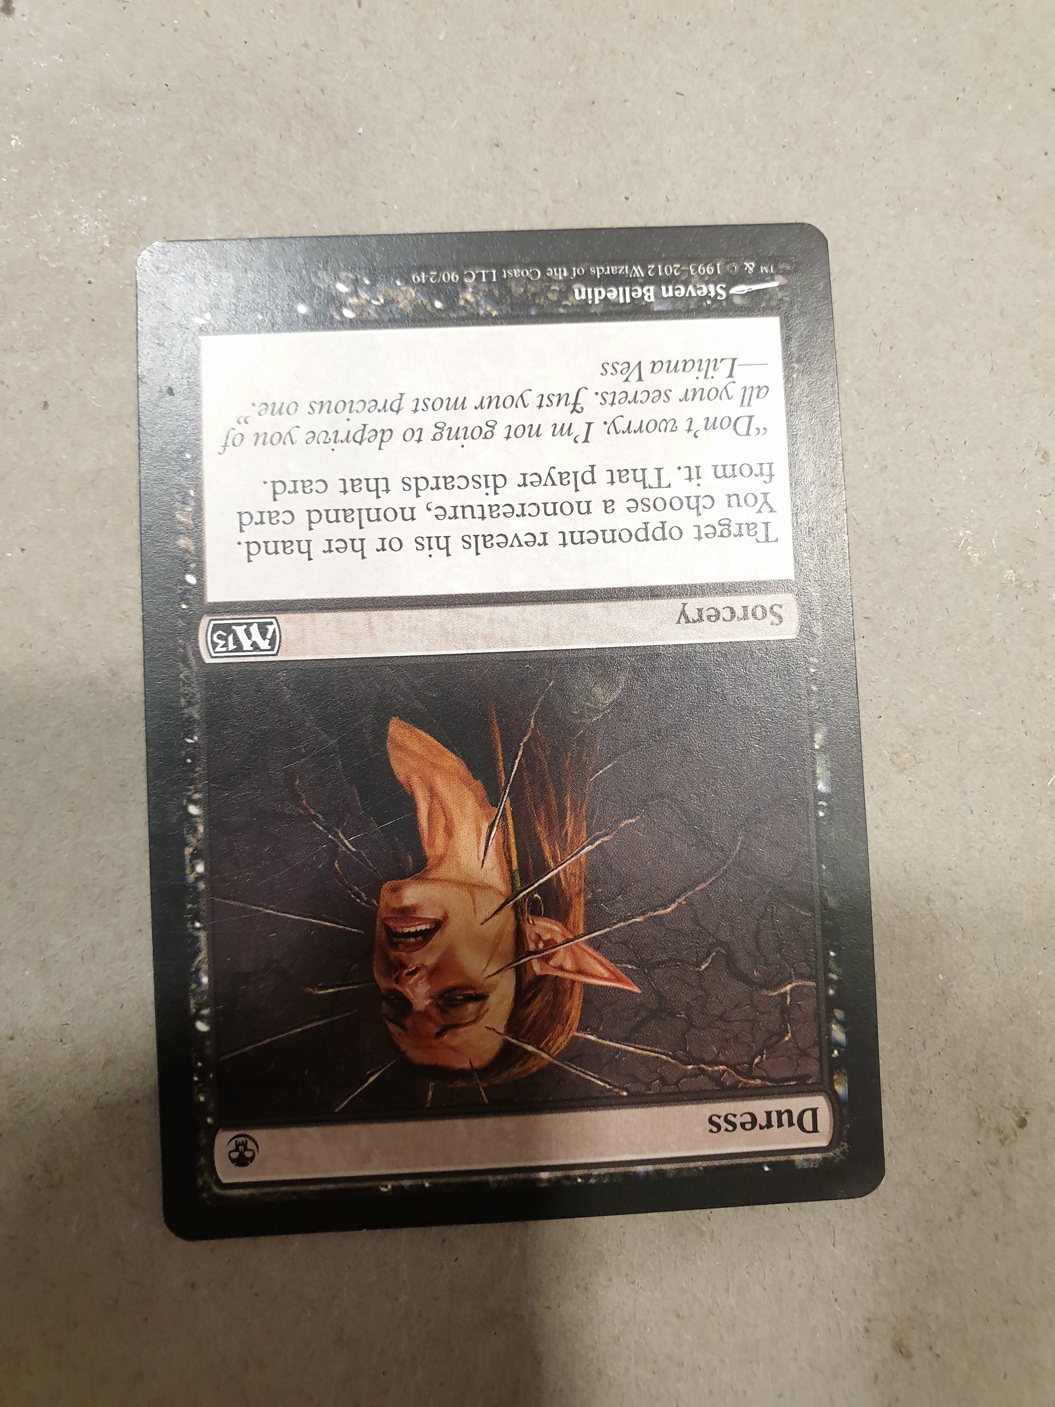
Text/OCR Examples
Text

Slide 10
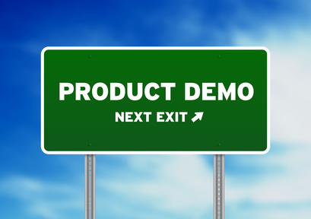
Demo

Slide 11

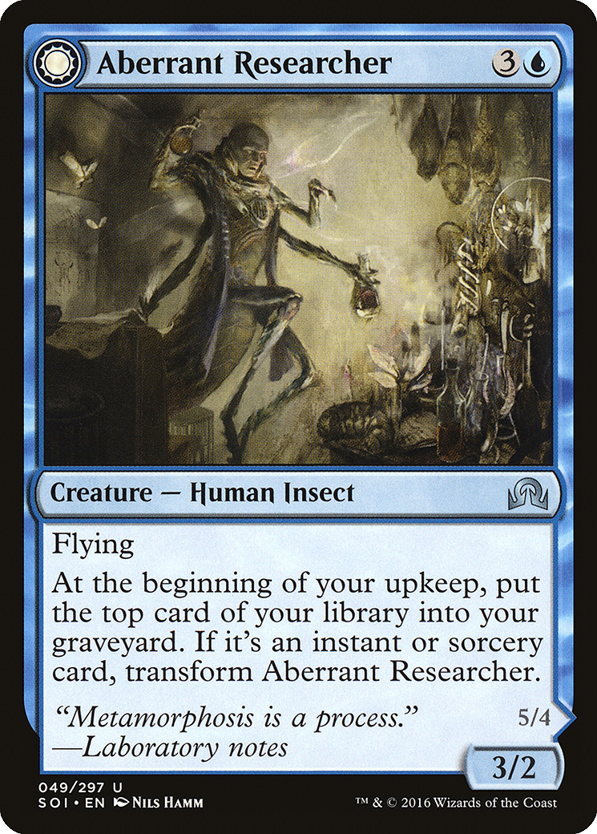
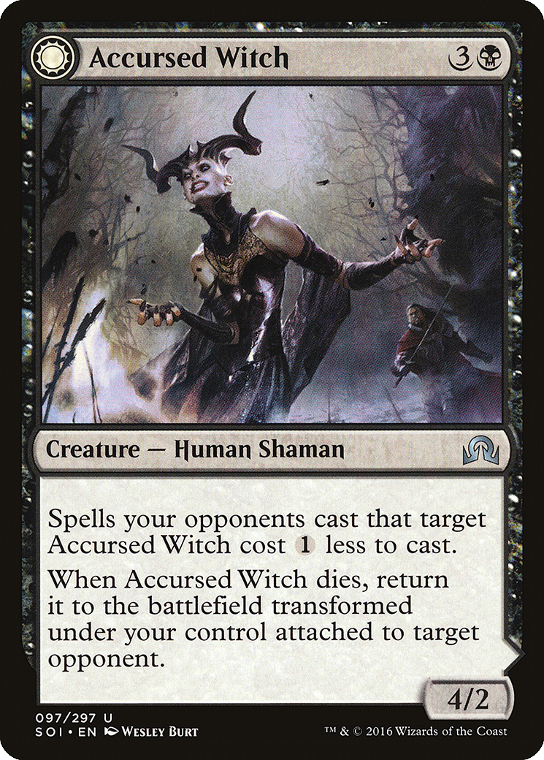
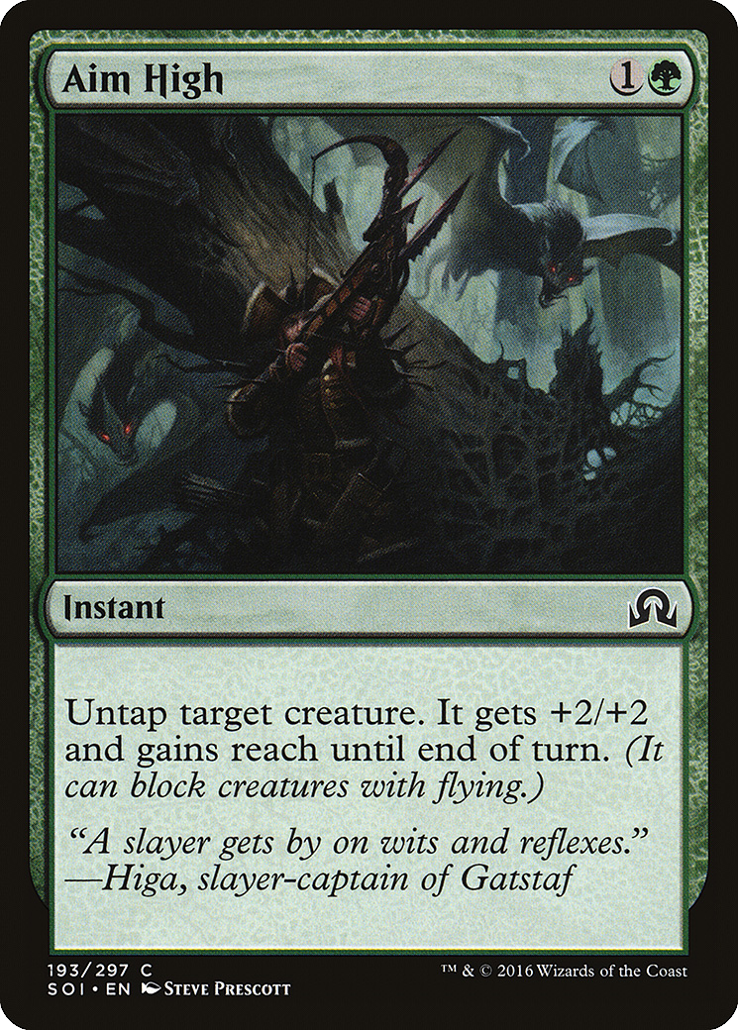
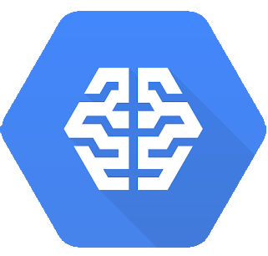
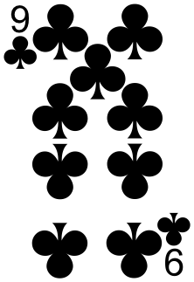
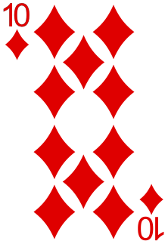
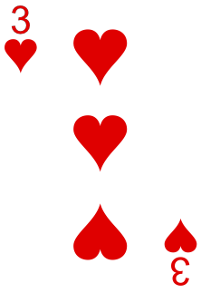
Finally AutoML
Great option for custom labels
Allows training
With as few as 100 images
Maybe eventually export model for edge processing
“Magic”
“Magic”
Confidence=99%
“Playing”

Slide 12
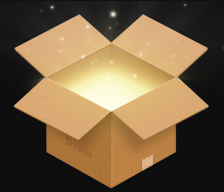
Deploy the App to GCP!

Slide 13
Questions
Code and images available on GitHub
https://github.com/richardagreene/PERTHdotnet-CardVision
Presentation in repo

